Slide 1

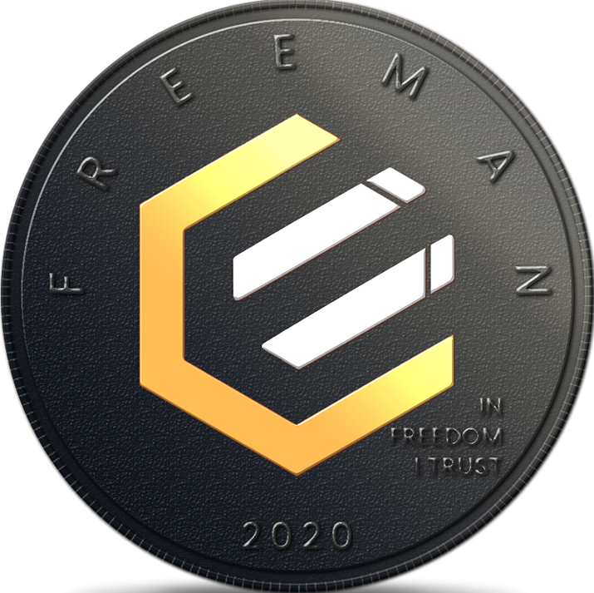











WHAT IS THE VALUE OF AN
EPIC?
“EPIC IS THE MOST PERFECT MONEY EVER CREATED”
CLASSICAL PROPERTIES:
SCARCE | 21M limited supply
FUNGIBLE | All units identical
DURABLE | Blockchain is forever
RECOGNIZABLE | Counterfeiting is impossible
PORTABLE | Instantly available everywhere there is internet
DIVISIBLE | 100 million units per coin
MARKETABLE | Can be used to obtain goods and services
EXTENDED TO TODAY’S NEEDS
EXTENSIBLE | Can easily be programmed + interconnected to work with other systems
CENSORSHIP RESISTANT | Protection from arbitrary seizure
THE EPIC BLOCKCHAIN ENABLES P2P FINANCIAL TRANSACTIONS THAT ARE:
ON A BLOCKCHAIN THAT IS:
TRUSTLESS
ANONYMOUS
IMMUTABLE
PERMISSIONLESS
OPEN
BORDERLESS
NEUTRAL
Bail-ins & Bail-outs
Issuer Risk
Inflation
Exchange Rate* Risk
Counterparty Risk
Negative Interest Rates
Credit Risk
AV ID:
Impairment of Property Rights
Default Risk
Confiscation
*To learn more about why this is so, visit freemanuniversity,org

